Slide 1


Chapters Content Archive Project
Internet Society / ISOC NY / ISOC MX
2026
AUGUST

Slide 2
Contents
What is the CCAP ?
How to participate ?
The Proof of Concept
What you need ?
Timeline of PoC
Thanks !
01
04
02
05
03
06
ISOC / CCAP POC

Slide 3
Our past and present: an archive
and tools for the future
The Chapter Content Archive Project enables the acquisition, cataloging, preservation and access to Chapter historical information as archives or fonds. Also facilitates the creation of audio and video which effectively acts as oral history source of the Internet Society global influence.
OBJECTIVES
To enable a community (chapters) owned & managed archive (digital repository of documents, audio & video) under library standards for communication, historic & research purposes with global distribution.
To provide seamless audio & video production and distribution facilities for enabling recording of Internet & Chapter related events in realtime
GOALS
Implementation of an archive of Chapters information for a) preservation, b) research & education, c) identity and culture
Preservation and access provision under international library standards and best practices in information management
Provision of accessible audio and video recording and distribution facilities for Chapters
ISOC / CCAP POC

Slide 4
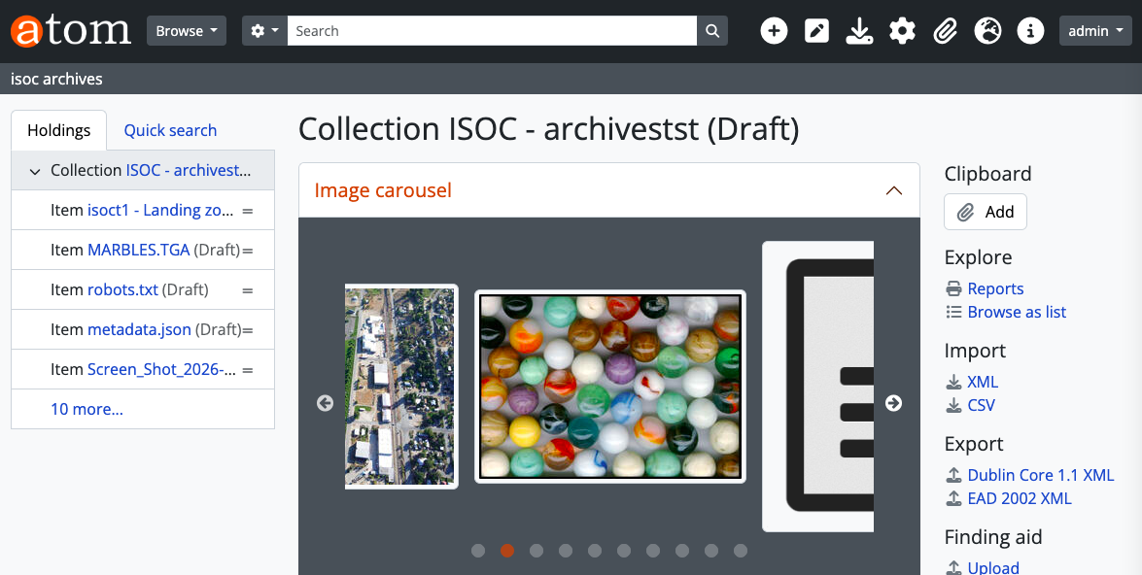
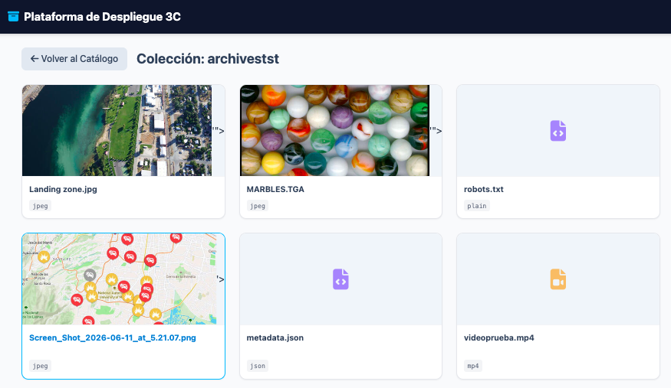
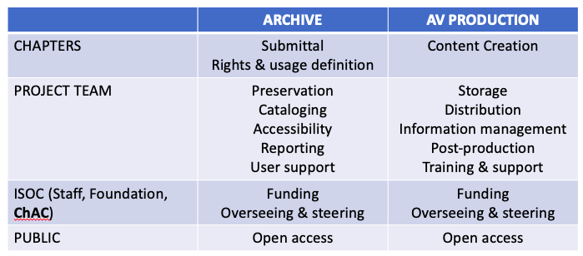
The Archive
Collection of documents and audiovisual materials ( audio, pictures, video) classified and catalogued under library standards. The archive is organized by fonds. Each chapter constitutes a fond. Chapters will be be able to upload and manage access to their documents.
The goals for the POC are to:
Provide basic training to chapters for selecting and
to provide information about records (materials).
Submit the records
Verify the records
Evaluate the experience

Slide 5
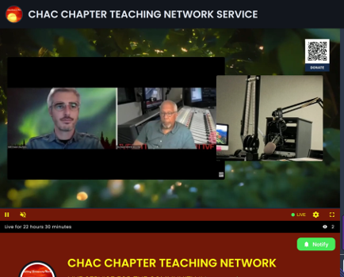
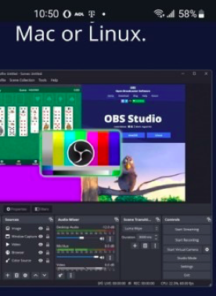
The A/V Tools
The CCAP will provide a set of tools for AV production, training on uploading to the storage infrastructure and streaming.
The goals for the POC are to:
Provide basic training to chapters on using the AV Tools.
Upload and stream at least one program
Evaluate the experience

Slide 6
The Proof of Concept (POC)
The Proof of Concept (POC) of the Chapter Content Archive Project (CCAP) aims to fine tune the design of the Mexico and New York chapters of the Internet Society. The CCAP POC is implemented through a fully functional Project Pilot (Pilot) with access to some ISOC Chapters resulting in a report that allows a long- term feasibility evaluation.
OBJECTIVE
The primary goal of the POC is to evaluate the operational functionality, reliability, and scalability of both physical and virtual infrastructure
GOALS
Validate End-to-End Workflow
System Deployment: Implementing the Archive Portal (indexing, metadata, search) and physical storage systems. And a fully functional set of tools for audiovisual production and live streaming and recording of ISOC Chapters events.
Reliability Testing
Scaling Blueprint
ISOC Chapters Acceptance (ChAC)
ISOC / CCAP POC

Slide 7
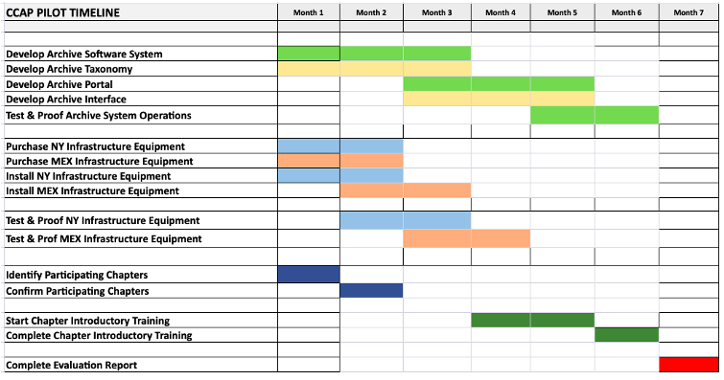
CCAP roadmap
Step 01
Step 02
ChAC Approval, ISOC Foundation grant
Design, Development and Testis. Equipment acquisition and software development
Step 03
Step 04
Chapters Call to Participation, Introductory session
Training and contents submittal
Step 05
Review & Report
Company Name

Slide 8
How to participate in the POC ?
Participating chapters are expected to allow some time to one to one sessions for achieving the goals of the Archive and/or the AV Tools. AV Tools Program will need some equipment (not provided by ISOC) to produce programs or recordings.
ARCHIVE PROGRAM
Confirm participation (mail to luism.martinez@ibero.mx)
Provide 5 records min.
1 hour online session training
Submit records before end of Nov.
Evaluate before end of Dec.
AV TOOLS PROGRAM
Confirm participation (mail to sar7148@gmail.com)
2 hour online session training (2 sessions 1hr each)
Produce 1 live or recorded program
Submit programs before end of Nov.
Evaluate before end of Dec.
ISOC / CCAP POC

Slide 9

Any questions?
Ask away!
CCAP Team
ISOC NY
Stuart Reid (sar7148@gmail.com), Doug Frazier (gdf@ddpny.org)
ISOC MX
Luis Martínez (luism.martinez@ibero.mx)
Company Name

